Slide 1
predicting Renewable Energy supply shortfalls using Time-series forecasting A Germany-based energy analytics system using forecasting, scenario analysis, battery storage optimization, and an interactive dashboard
Presented by: Kaitlyn Khan, Varsha Roopchand, Micah Hosein, Adam Mohammed and Daniel Mangal
Notes:
Good morning everyone. Our project focuses on predicting renewable energy supply shortfalls in Germany. The main idea is to understand when wind and solar generation may not be enough to meet electricity demand, and then use forecasting, scenario analysis, and battery storage modelling to support energy planning

Slide 2
The project scope in 3 numbers
50,295
4 models
3 scenarios
hourly observations in the final merged dataset
random forest with lag, random forest without lag, prophet and neuralProphet
worst, average and best renewable generation cases
Notes:
At a high level, our project used over fifty thousand hourly observations, compared four forecasting approaches, and then extended the analysis into three renewable generation scenarios. So the project is not only about predicting shortfall, but also about helping users understand what could happen under different renewable conditions.

Slide 3
The problem:
Renewable energy is cleaner, but it does not always appear at the same time as electricity demand.
Shortfall = Demand – Wind Generation - Solar Generation
The issue
The risk
The gap
Wind and solar generation depend on weather
Demand still has to be met every hour, even when renewable output is low
Wind and solar generation depend on weather
Notes:
The problem is not that renewable energy is bad. The problem is that it is variable. Solar depends on sunlight, wind depends on wind speed, but electricity demand still exists even when the weather is not ideal. So our project focuses on predicting the gap between demand and renewable generation

Slide 4
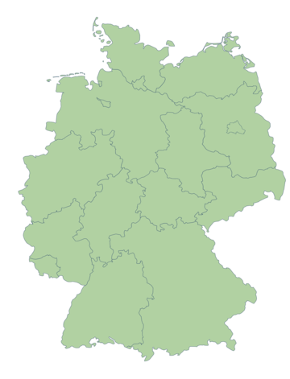
Why Germany?
Germany has major wind and solar development
Seasonal weather variation creates forecasting challenges
Winter periods can have lower solar output and high demand
Public electricity data makes the project reproducible
Notes:
We chose Germany because it has a strong renewable energy sector, but also strong seasonal variation. That makes it a good country to study because renewable output can change a lot across the year, especially between summer and winter.

Slide 5
Data sources
Electricity data
Weather data
Electricity data came from Open power system data.
Germany electricity load, Germany wind generation, Germany solar generation.
Weather data came from NASA power API.
Weather variables: solar irradiance, wind speed at 10m, temperature at 2m.
Weather was collected for 5 German cities – Berlin, Hamburg, Munich, Frankfurt, Cologne
Notes:
We combined electricity data with weather data because wind and solar generation are directly connected to weather. Solar irradiance helps explain solar output, wind speed helps explain wind output, and temperature can also relate to demand patterns.

Slide 6
Data preparation
Converted timestamps into a consistent UTC format.
Filtered the data to the study period.
Merged electricity and weather data by timestamp.
Removed rows with missing required values.
Created a complete modelling dataset for forecasting.
Electricity data
Weather data
Cleaning
Merge
Feature engineering
Model dataset
Notes:
Before modelling, we had to clean and align the data. Since this is time-series data, timestamp consistency was very important. After merging the electricity and weather datasets, we removed missing values and prepared the data for forecasting.

Slide 7
Renewable energy shortfall
The target was the amount of unmet demand.
Positive shortfall means wind and solar were not enough.
Near-zero or negative values mean renewables nearly met or exceeded demand.
This became the main value our models implemented.
Shortfall_mw = load_mw – wind_generation_mw – solar_generation_mw
Positive value = unmet demand
Notes:
The most important variable in our project is renewable energy shortfall. We calculated it by subtracting wind and solar generation from electricity load. This tells us how much demand is still left after renewable generation is counted.

Slide 8
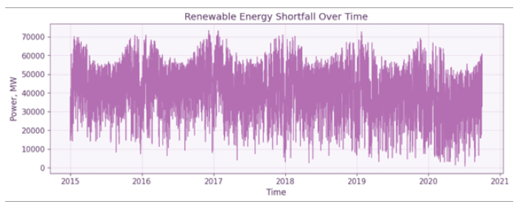
Shortfall shows strong seasonal and daily variation
Shortfall varies across months and years.
Winter periods show larger shortfall risk.
The pattern is not random, it indicates seasonality.
Forecasting must capture both long-term trends and short-term spikes.
Shortfall is persistent and volatile, so the model must capture both seasonal structure and sudden changes.
Notes:
This chart shows that shortfall is not just random. It has repeating seasonal behaviour, but it also has sharp spikes. That is why time-series forecasting is useful here. The model needs to learn both the big seasonal patterns and the smaller short-term movements

Slide 9
Methodology pipeline
Collect electricity and weather data.
Clean, merge and engineer features.
Train and compare forecasting models.
Generate worst, average and best scenarios.
Simulate battery storage and display results in the dashboard.
Data
Cleaning
Features
Models
Scenarios
Battery storage
Dash board
Notes:
Our workflow starts with data collection and cleaning, then feature engineering, then model training. After selecting the best model, we extend the project with scenario analysis and battery storage simulation. The dashboard then makes those results easier to explore.

Slide 10
Feature Engineering
These features helped the models understand weather effects, time patterns and recent shortfall behaviour.
Weather features
Time features
Lag features
Solar irradiance, wind speed, temperature
These explain changes in solar output, wind output and demand.
Hour, day of the week, month, day of year.
These capture daily routines and seasonal energy cycles.
Previous 1 hour, 24 hours and 168 hours shortfall.
These tell the model what happened recently, last hour, 24 hours and last week.
Notes:
Feature engineering basically means turning the raw data into useful signals for the model. We did not only give the model weather values. We also gave it time information, like the hour and month, because electricity demand and renewable generation follow daily and seasonal cycles. Most importantly, we created lag features, meaning past shortfall values from the previous hour, previous day, and previous week. This matters because energy systems have patterns. What happened recently often helps predict what will happen next.

Slide 11
Models compared
Random forest with lag
Random forest without lag
Uses weather, time and recent history
Tests how well weather and time features work alone
Prophet
Neuralprophet
Captures trend and seasonality in the time series
Adds neural network learning and autoregressive history.
Notes:
We did not only test one model. We compared four setups so we could see what actually improved forecasting. The Random Forest without lag served as a useful comparison because it shows what happens when the model does not have recent historical shortfall values.

Slide 12
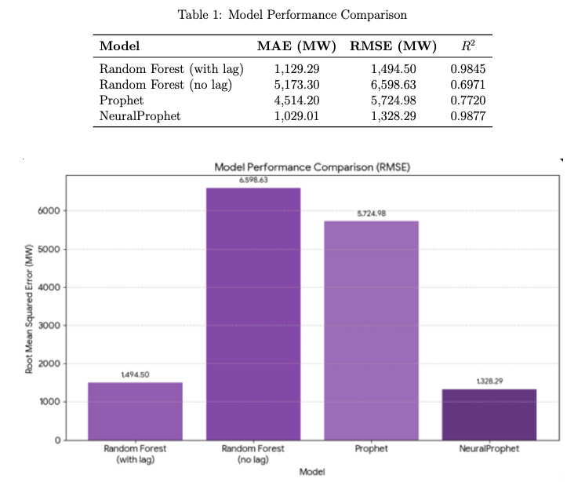
Model results
NeuralProphet had the lowest RMSE: 1,328.29 MW
NeuralProphet had the highest R squared: 0.9877
Random forest improved greatly when lag features were added
Temporal dependence was the strongest predicator
Notes:
The main result is that NeuralProphet was the best model. It had the lowest RMSE and the highest R². The comparison also shows that lag features matter a lot. Random Forest with lag features performed much better than Random Forest without lag features, meaning recent history carries a lot of information.

Slide 13
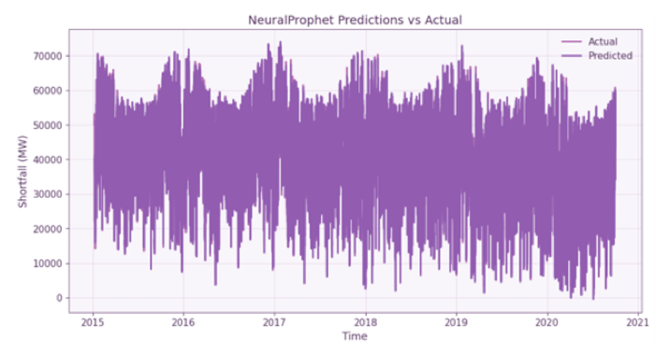
Prediction Results
NeuralProphet predictions closely overlapped the actual shortfall values.
Long-term seasonality and high-frequency daily movement
Sudden weather shifts and demand spikes can still cause deviations
The model is strong enough to support shortfall monitoring and planning
Notes:
This chart helps prove that the model is not only good on paper. Visually, the prediction follows the actual pattern closely. It still has small errors during sudden changes, which makes sense because those are harder for any model to predict.

Slide 14
Scenario analysis and results
Demand was held constant so the change in shortfall came from renewable generation.
Worst case
Average case
Best case
Wind x 0.70
Solar x 0.65
Low renewable output
Wind x 1.00
Solar x 1.00
Historical baseline
Wind x 1.30
Solar x 1.35
High renewable output
19.9% coverage
29.0% coverage
38.1% coverage
Renewable output improves across scenarios, but demand remains much larger than wind and solar generation
Notes:
The scenarios help us move beyond one forecast. The worst case represents low wind and low solar output, the average case is the baseline, and the best case represents higher renewable output. Demand was kept constant so we could isolate how changes in renewable generation affect shortfall. Even in the best case, renewables covered only 38.1% of average demand, and shortfall still occurred on 2,094 out of 2,101 days. So the scenario analysis shows that increasing renewable output helps, but it does not remove the need for storage, imports, or backup generation.

Slide 15
Shortfall heatmap
Shortfall severity changes by month, showing that the energy gap is seasonal, not just random.
Winter stress: Shortfall is usually higher in colder months.
Summer relief: solar output helps reduce the shortfall but does not remove it
Worst case: consistently shows the larges shortfalls
Notes:
The heatmap makes the seasonal pattern easier to see. The redder cells show larger shortfalls. This matters because grid planning is not only about the average shortfall. It is also about knowing when the system is most stressed

Slide 16
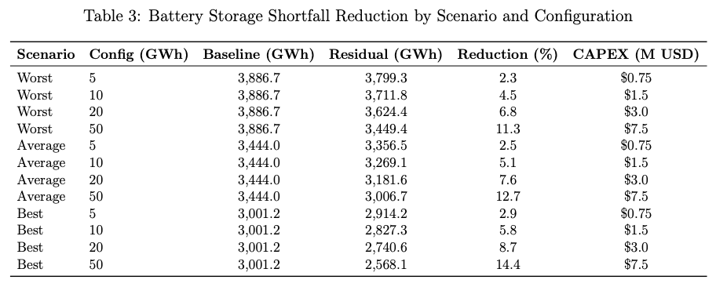
Battery storage model
Battery storage was simulated to test how much of the renewable shortfall could be reduced.
Battery sizes tested
5 GWh battery: 2.3%-2.9% shortfall reduction
20 GWh battery: 6.8%-8.7% shortfall reduction
50 GWh battery: 11.3%-14.4% shortfall reduction
Purpose
Measure shortfall reduction under each scenario
Larger batteries reduce more shortfall, but even 50 GWh does not fully solve the problem
Notes:
The battery model uses a greedy dispatch method. That means when renewables exceed demand, the battery charges. When there is a shortfall, the battery discharges to reduce unmet demand. It also uses realistic constraints like efficiency, state of charge limits, and charging/discharging limits. Battery storage does help, and the reduction improves as capacity increases. But even the largest battery tested only reduced shortfall by 11.3% to 14.4%. That means batteries are part of the solution, but not the full solution.

Slide 17
Demo Video
https://drive.google.com/file/d/14wiDUOAPB-DD-DRknMUOcWAD4l8CykYq/view?usp=sharing

Slide 18
Limitations
Scenario simplification: Uses fixed multipliers instead of full probabilistic weather forecasts.
Battery scale: 50 GWh is still small compared to national shortfall levels.
Daily aggregation: Battery simulation uses daily data which may miss hourly cycling behaviour.
System boundary: Germany is treated as one national system.
Notes:
This slide is important because it shows we understand the trade-offs. The scenarios are simplified, the battery sizes are limited, and the battery simulation uses daily data. So the results should be seen as a decision-support analysis, not a perfect simulation of the entire German grid.

Slide 19
Conclusion
Key finding 1: NeuralProphet was the strongest forecasting model.
Key finding 2: Renewable output alone did not meet demand in any scenario
Key finding 3: battery storage reduced shortfall, but did not eliminate it.
Future work: Use real weather forecasts, hourly storage modelling, more storage types and real-time dashboard updates.
Notes:
Our final takeaway is that forecasting can be accurate and useful, but forecasting alone does not fix the energy gap. NeuralProphet performed best, the scenario analysis showed persistent shortfall, and the battery results showed that storage helps but cannot solve the problem by itself at the tested scale. Future work would make the model more realistic using live weather forecasts, hourly storage simulation, and additional storage technologies.

Slide 20
Thanks!
Do you have any questions?

